Slide 1
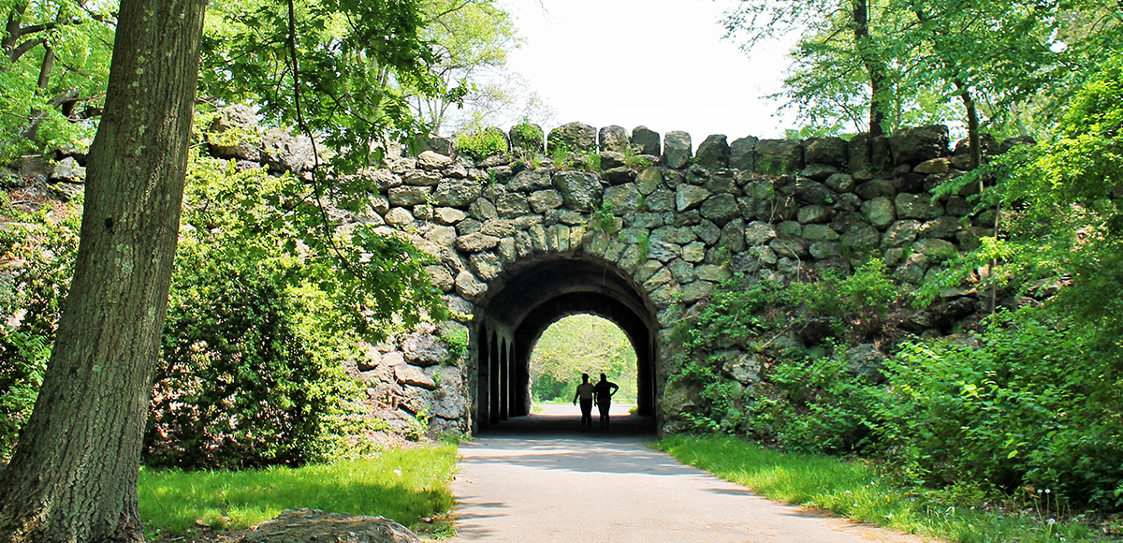
Predicting Invasive Understory Species Presence in Boston’s Deciduous Forests
Chad Fisher | UEP 294 | Final Project | 4.24.24
Notes:
https://www.tclf.org/sites/default/files/thumbnails/image/MA_Boston_FranklinPark_courtesyEmeraldNecklaceConservancy_2020_001_sig.jpg

Slide 2




Updated Research Question
How can supervised machine learning and harmonic regression be used to differentiate invasive and native understory species in Boston’s deciduous forests using 2023 Sentinel-2 data?

Slide 3
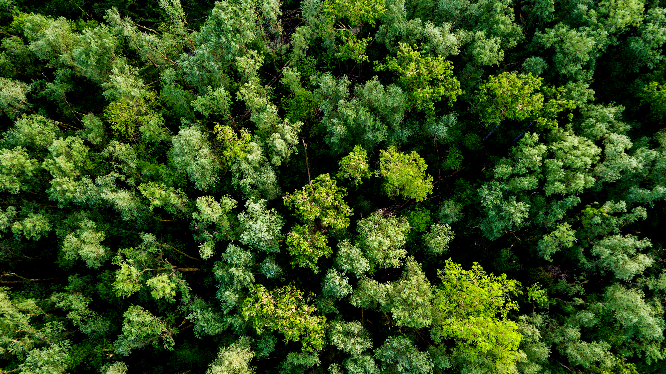
Methods

Slide 4
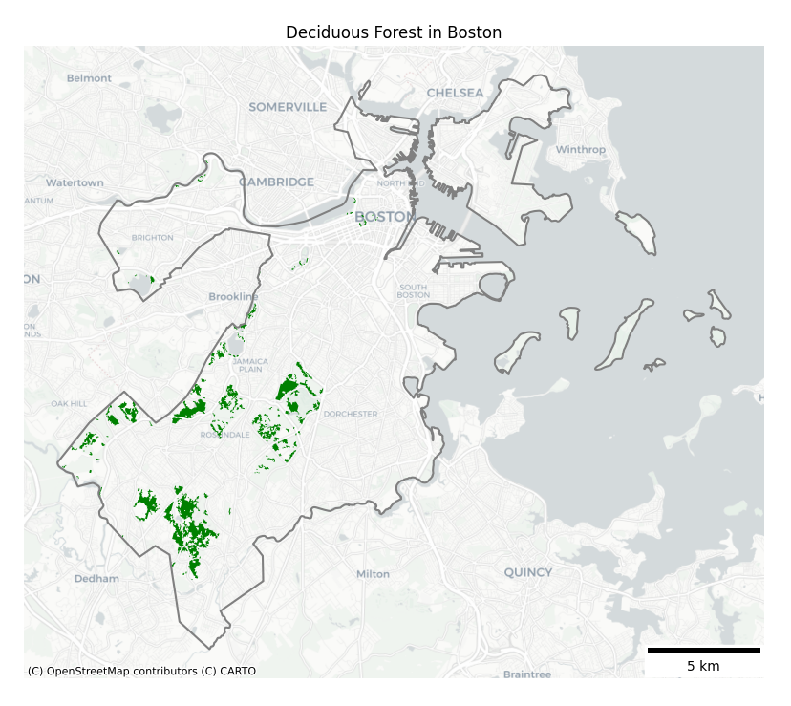
Preprocessing
1
2023 Sentinel-2 Data
2
Filter for <50% cloud coverage
3
Clip to Boston Deciduous Forests
4
Apply cloud mask
Mosaic same day images together
5

Slide 5




Extract Time Series Characteristics
1
Harmonic regression was performed pixelwise for each of the 10 bands and 4 indices using time series data
2
Band | Wavelength
B2 | Red
B3 | Green
B4 | Blue
B5 | RE 1
B6 | RE 2
B7 | RE 3
B8 | NIR
B8A | RE 4
B11 | SWIR 1
B12 | SWIR 2
3
Reflectance
4
Day of the Year
J
F
M
A
M
J
J
A
S
O
N
D
$$NDVI=\frac{NIR−Red}{NIR+Red}$$
$$RENDVI=\frac{RE_{2}−RE_{1}}{RE_{2}+RE_{1}}$$
5
80 total images used
$$NBR=\frac{SWIR2−NIR}{SWIR2+NIR}$$
$$SAVI=\frac{1.5\left(NIR−Red\right)}{NIR+Red+0.5}$$

Slide 6
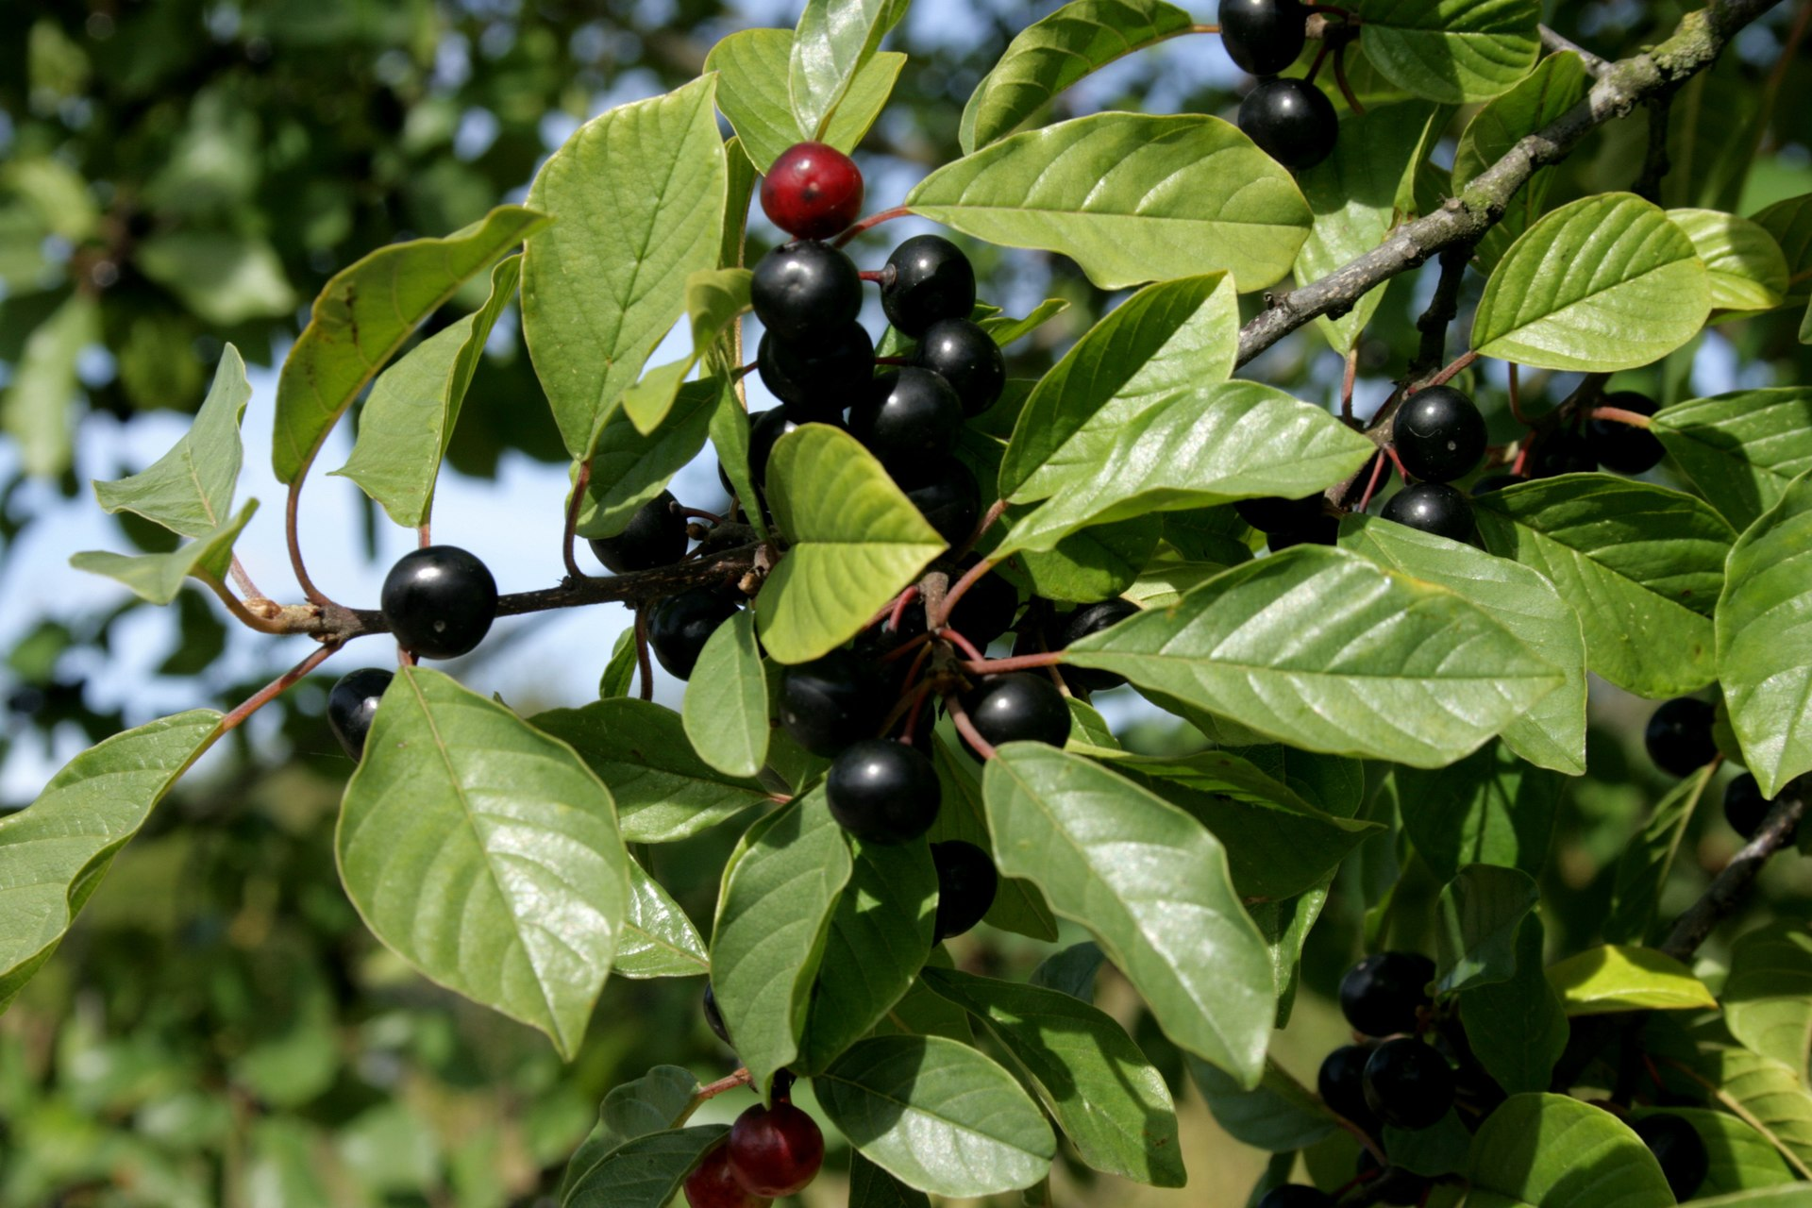
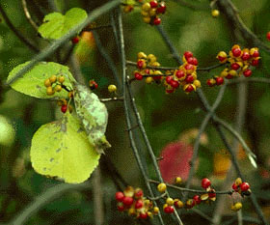
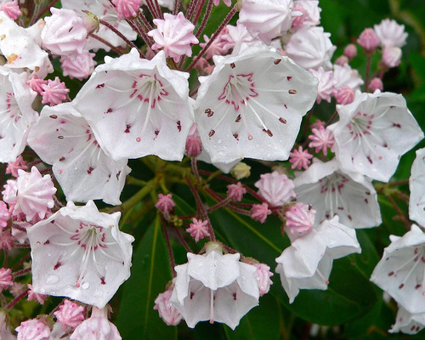
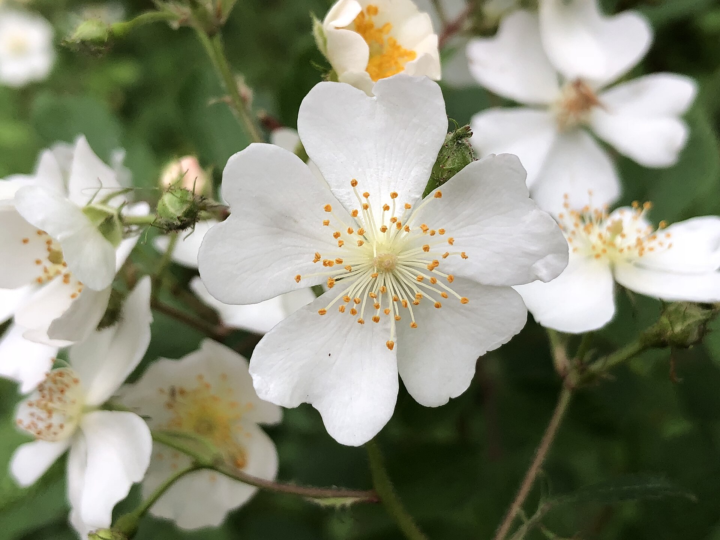
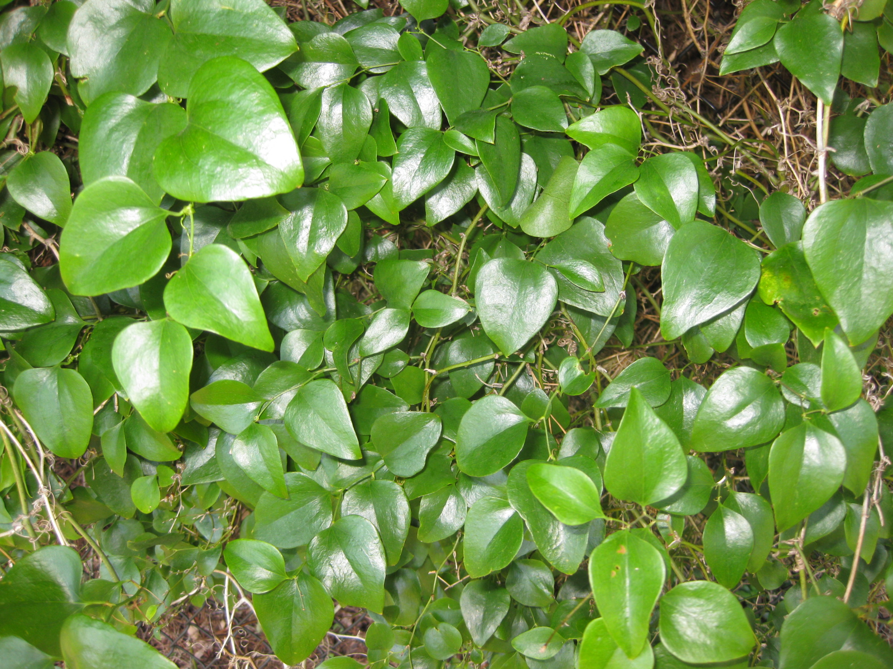
Training Data Collected
1
iNaturalist observations (2022 – present) extracted from their API of:
2
3 early invasives
2 important natives
3
Glossy Buckthorn
Frangula alnus
Asian Bittersweet
Celastrus orbiculatus
Mountain Laurel
Kalmia latifolia
4
5
Multiflora Rose
Rosa multiflora
Roundleaf Greenbrier
Smilax rotundifolia

Slide 7
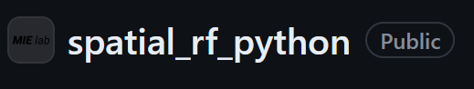
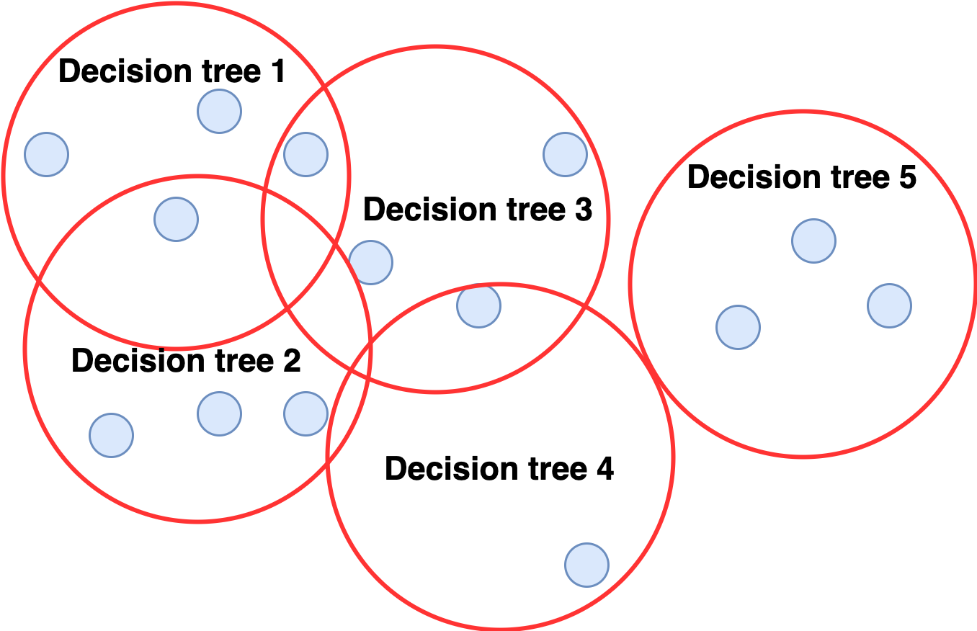
Random Forest Classifiers
1
Implemented with GitHub package spatial RF from Mobility Information Engineering Lab at ETH Zürich
2
Used the 9 regression coefficients and the RMSE for the 10 bands and 4 indices resulting in 140 input variables
3
Basic: no spatial information provided to model
Geographic: includes spatial information and trains sub-RFs on small areas
Spatial: more efficient version of geographic that trains only decisions trees on distinct areas and weights by distance
Spatial, tuned: same as above but tuned for neighbor of numbers with lowest error
4
5

Slide 8
Validation and Prediction
1
2
Calculated accuracy information and confusion matrix for each classifier
&
Generated output map of predicted class for each 10 m deciduous forest pixel (according to 2019 NLCD)
3
4
5

Slide 9

Results

Slide 10
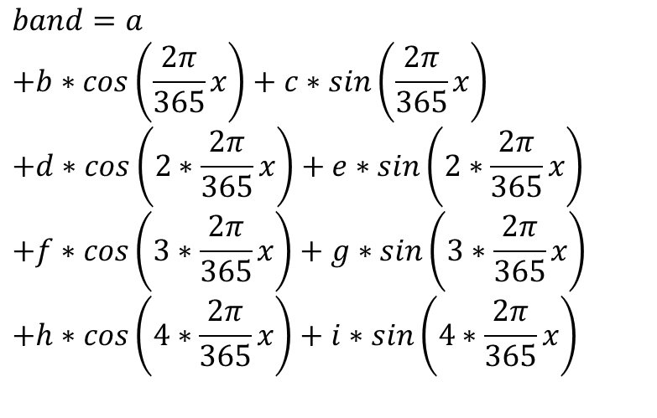
Harmonic Regression
$$band=a$$
$$+b∗cos\left(\frac{2π}{365}x\right)+c∗sin\left(\frac{2π}{365}x\right)$$
$$+d∗cos\left(2∗\frac{2π}{365}x\right)+e∗sin\left(2∗\frac{2π}{365}x\right)$$
$$+f∗cos\left(3∗\frac{2π}{365}x\right)+g∗sin\left(3∗\frac{2π}{365}x\right)$$
$$+h∗cos\left(4∗\frac{2π}{365}x\right)+i∗sin\left(4∗\frac{2π}{365}x\right)$$
Time Series

Slide 11
Harmonic Regression
Seasonality:
$$band=a$$
$$+b∗cos\left(\frac{2π}{365}x\right)+c∗sin\left(\frac{2π}{365}x\right)$$
$$+d∗cos\left(2∗\frac{2π}{365}x\right)+e∗sin\left(2∗\frac{2π}{365}x\right)$$
$$+f∗cos\left(3∗\frac{2π}{365}x\right)+g∗sin\left(3∗\frac{2π}{365}x\right)$$
$$+h∗cos\left(4∗\frac{2π}{365}x\right)+i∗sin\left(4∗\frac{2π}{365}x\right)$$
Yearly
Time Series

Slide 12
Harmonic Regression
Seasonality:
$$band=a$$
$$+b∗cos\left(\frac{2π}{365}x\right)+c∗sin\left(\frac{2π}{365}x\right)$$
$$+d∗cos\left(2∗\frac{2π}{365}x\right)+e∗sin\left(2∗\frac{2π}{365}x\right)$$
$$+f∗cos\left(3∗\frac{2π}{365}x\right)+g∗sin\left(3∗\frac{2π}{365}x\right)$$
$$+h∗cos\left(4∗\frac{2π}{365}x\right)+i∗sin\left(4∗\frac{2π}{365}x\right)$$
Yearly
6-month
Time Series

Slide 13
Harmonic Regression
Seasonality:
$$band=a$$
$$+b∗cos\left(\frac{2π}{365}x\right)+c∗sin\left(\frac{2π}{365}x\right)$$
$$+d∗cos\left(2∗\frac{2π}{365}x\right)+e∗sin\left(2∗\frac{2π}{365}x\right)$$
$$+f∗cos\left(3∗\frac{2π}{365}x\right)+g∗sin\left(3∗\frac{2π}{365}x\right)$$
$$+h∗cos\left(4∗\frac{2π}{365}x\right)+i∗sin\left(4∗\frac{2π}{365}x\right)$$
Yearly
6-month
4-month
Time Series

Slide 14
Harmonic Regression
Seasonality:
$$band=a$$
$$+b∗cos\left(\frac{2π}{365}x\right)+c∗sin\left(\frac{2π}{365}x\right)$$
$$+d∗cos\left(2∗\frac{2π}{365}x\right)+e∗sin\left(2∗\frac{2π}{365}x\right)$$
$$+f∗cos\left(3∗\frac{2π}{365}x\right)+g∗sin\left(3∗\frac{2π}{365}x\right)$$
$$+h∗cos\left(4∗\frac{2π}{365}x\right)+i∗sin\left(4∗\frac{2π}{365}x\right)$$
Yearly
6-month
4-month
3-month
Time Series

Slide 15
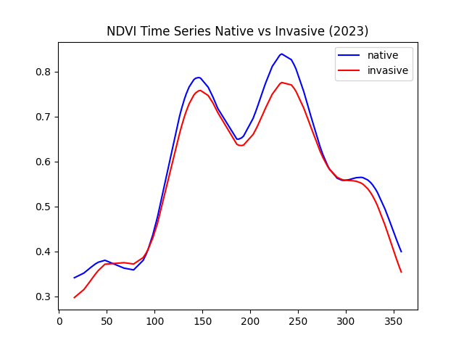
Harmonic Regression
scipy.optimize.curve_fit()
(non-linear least squares regression)
Seasonality:
$$band=a$$
$$+b∗cos\left(\frac{2π}{365}x\right)+c∗sin\left(\frac{2π}{365}x\right)$$
$$+d∗cos\left(2∗\frac{2π}{365}x\right)+e∗sin\left(2∗\frac{2π}{365}x\right)$$
$$+f∗cos\left(3∗\frac{2π}{365}x\right)+g∗sin\left(3∗\frac{2π}{365}x\right)$$
$$+h∗cos\left(4∗\frac{2π}{365}x\right)+i∗sin\left(4∗\frac{2π}{365}x\right)$$
Yearly
6-month
4-month
3-month
Time Series

Slide 16
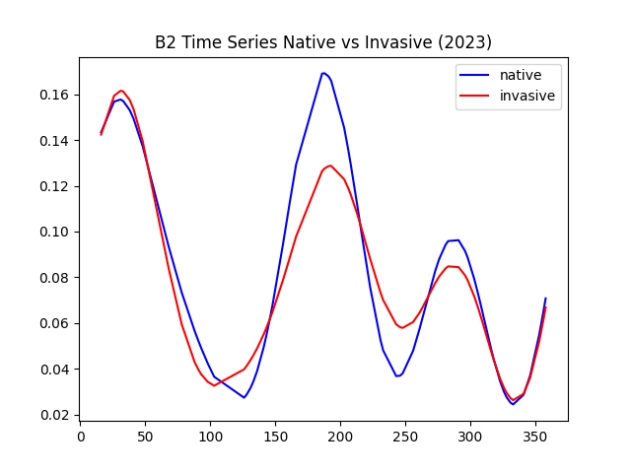
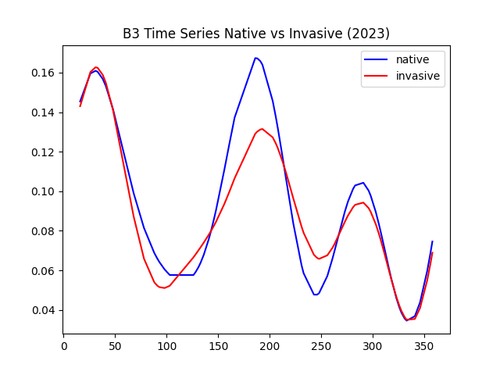
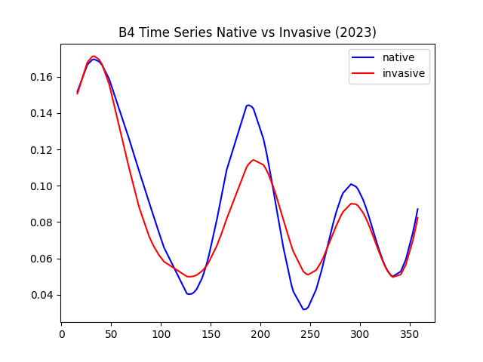
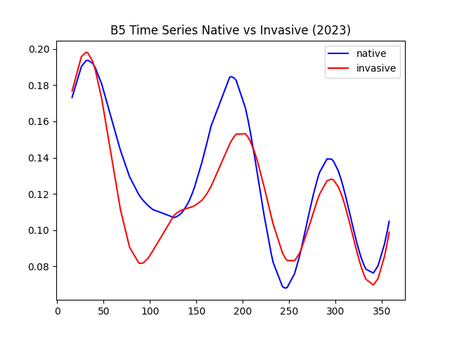
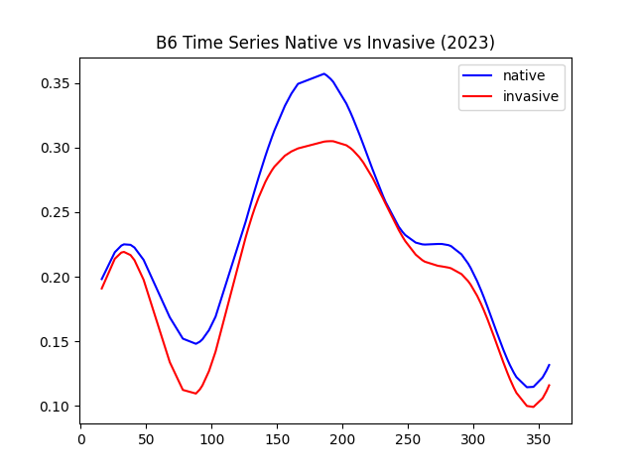
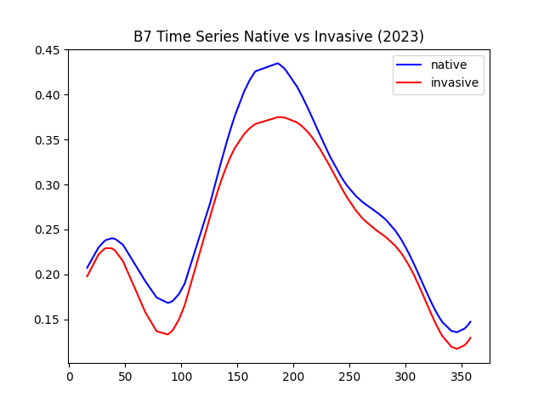
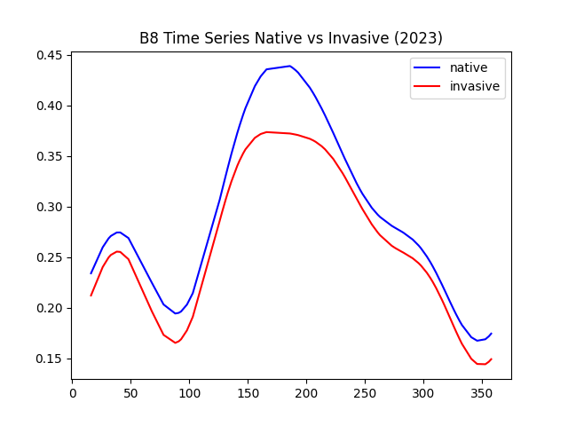
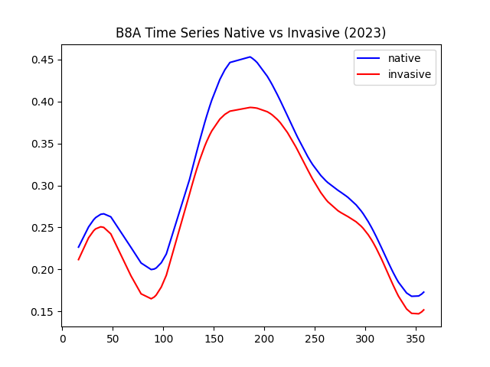
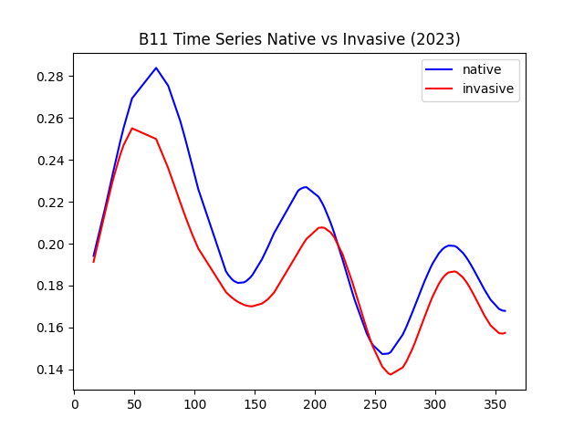
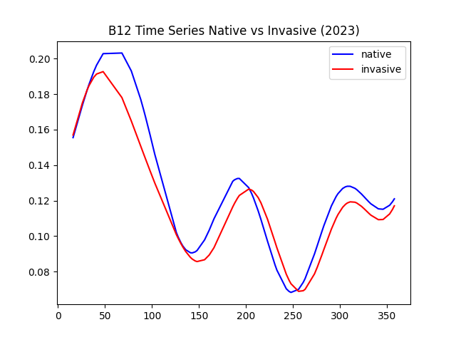
Regressions for Bands
Time Series

Slide 17
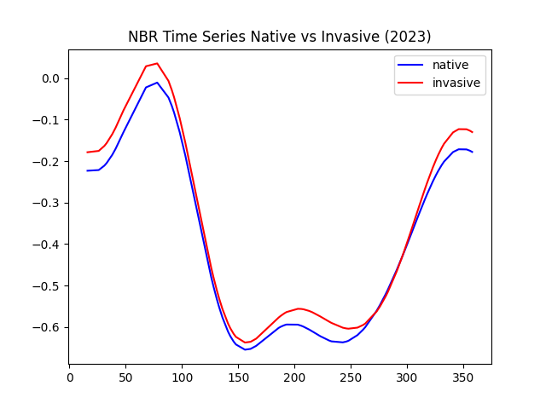
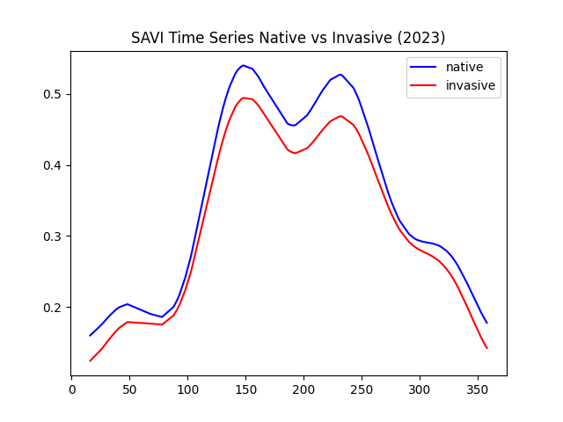
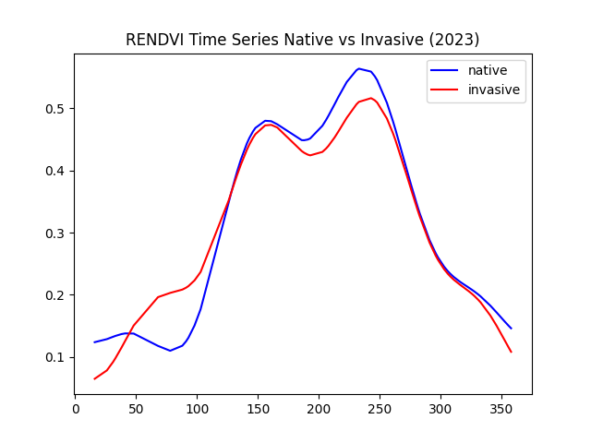
Regressions for Indices
Time Series

Slide 18
Regressions for Indices
Time Series

Slide 19
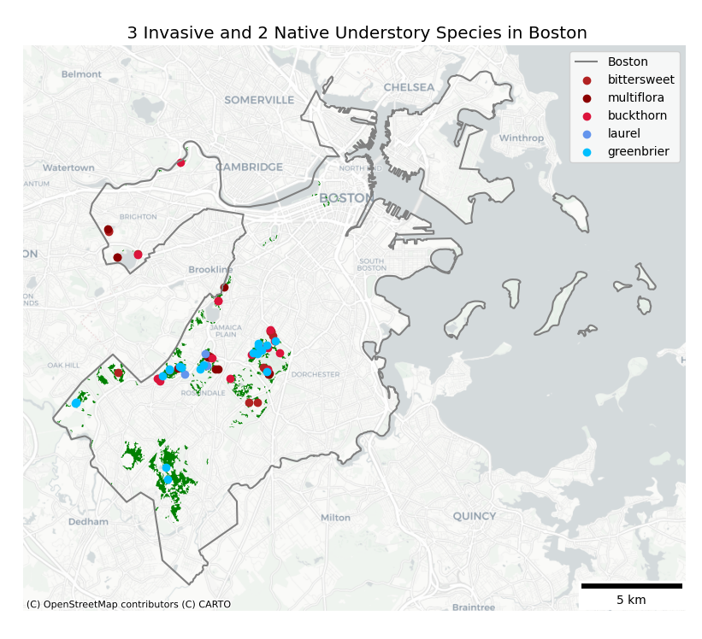
iNaturalist Training Sites
Training Data

Slide 20
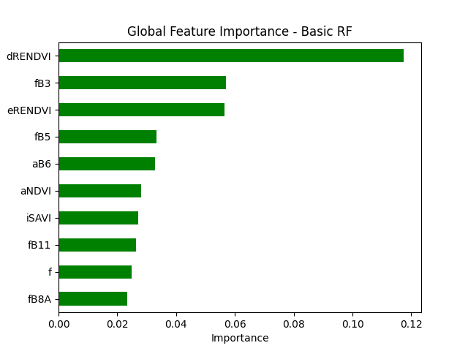
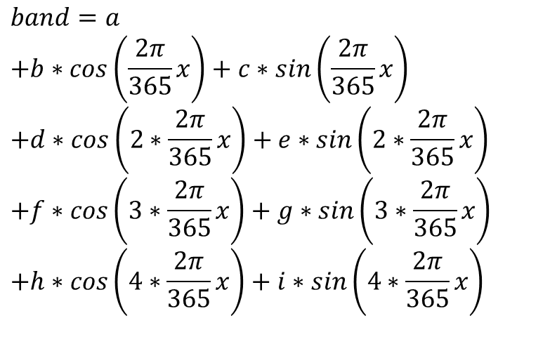
Feature Importance
$$band=a$$
$$+b∗cos\left(\frac{2π}{365}x\right)+c∗sin\left(\frac{2π}{365}x\right)$$
$$+d∗cos\left(2∗\frac{2π}{365}x\right)+e∗sin\left(2∗\frac{2π}{365}x\right)$$
$$+f∗cos\left(3∗\frac{2π}{365}x\right)+g∗sin\left(3∗\frac{2π}{365}x\right)$$
$$+h∗cos\left(4∗\frac{2π}{365}x\right)+i∗sin\left(4∗\frac{2π}{365}x\right)$$
Random Forest

Slide 21
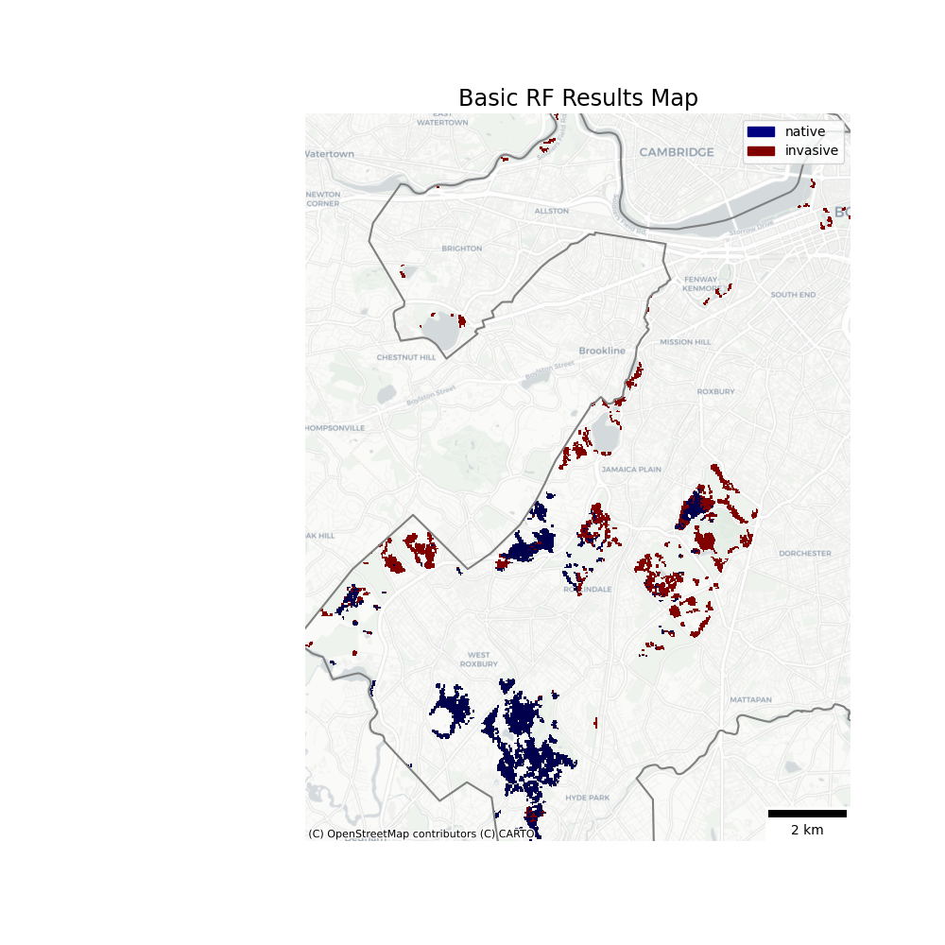
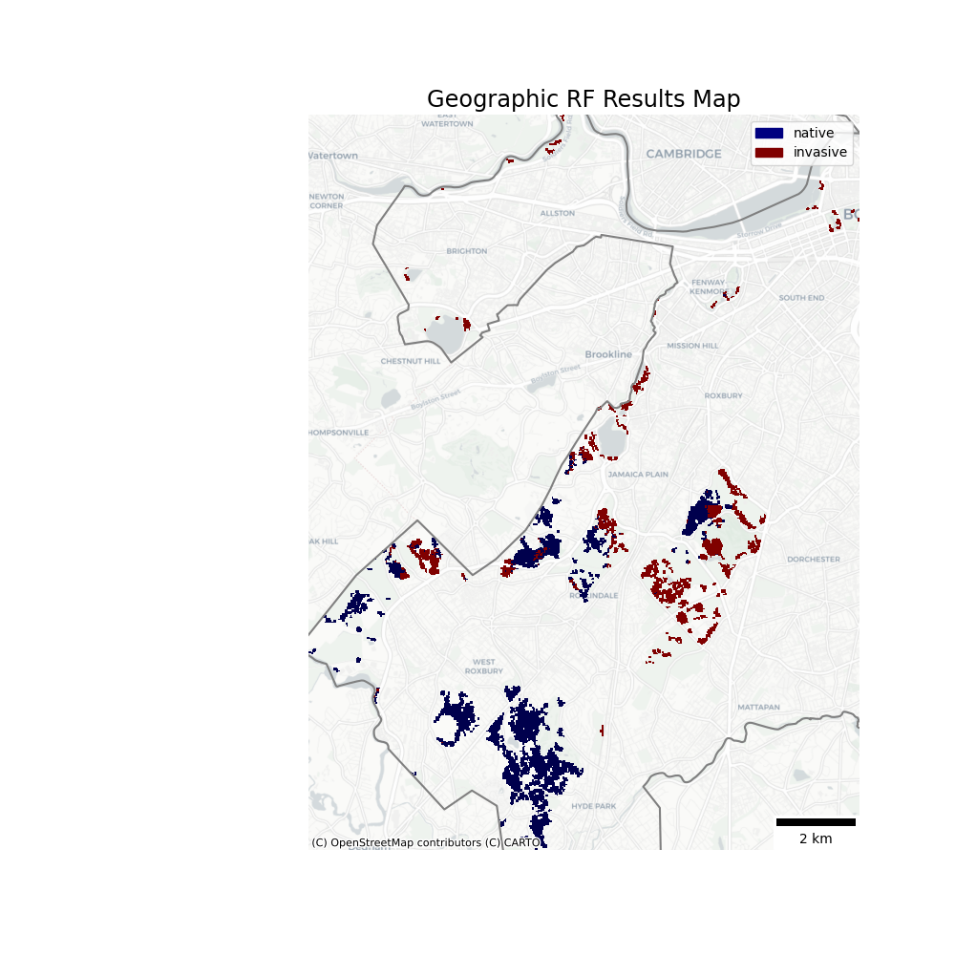
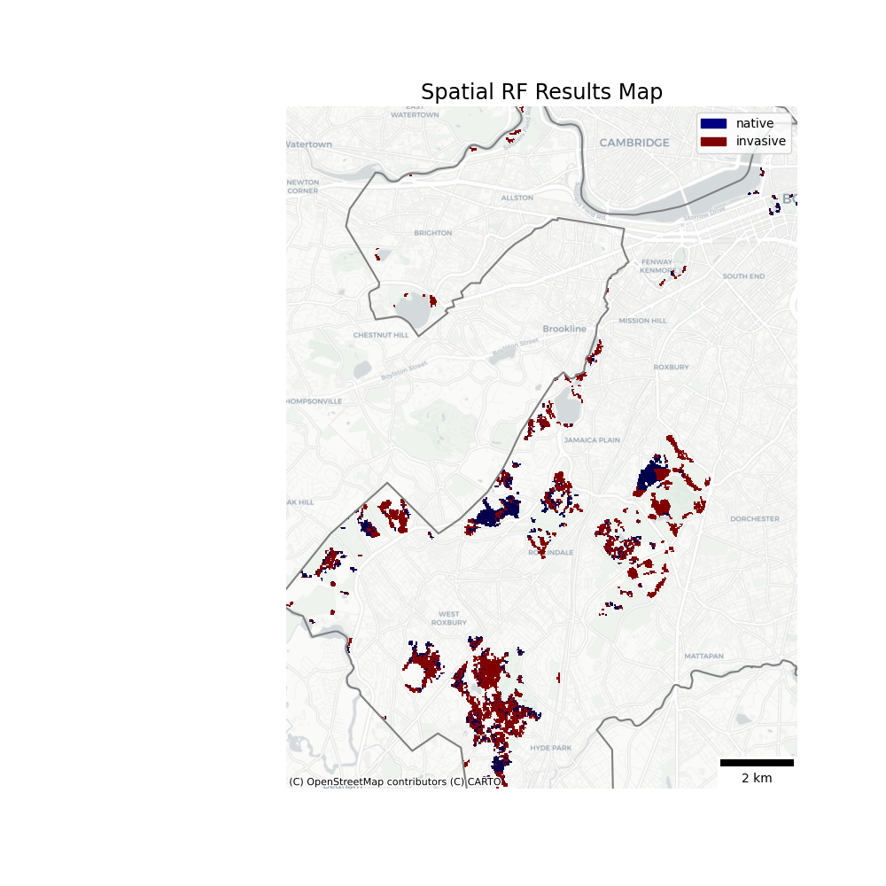
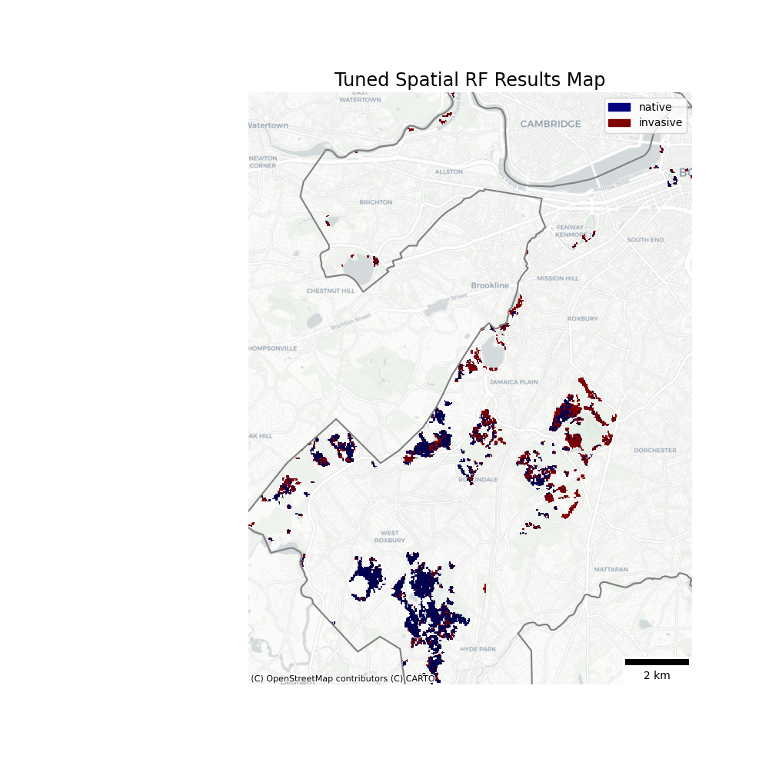
Random Forest Results
Random Forest

Slide 22
Accuracy Metrics
Model | Producer’s Accuracy (natives, invasives) | User’s Accuracy (natives, invasives) | Overall Accuracy | Kappa | Predicted Coverage by Invasives
Basic | 81%, 100% | 100%, 86% | 91.1% | 0.82 | 41.3%
Geographic | 85.7%, 100% | 100%, 88.9% | 93.3% | 0.86 | 34.1%
Spatial | 66.7%, 100% | 100%, 77.4% | 84.4% | 0.68 | 71.0%
Spatial, tuned | 76.2%, 95.8% | 94.1%, 82.1% | 86.7% | 0.73 | 34.6%
Validation

Slide 23
Runtime for Using Models to Predict
Validation

Slide 24

Discussion

Slide 25

Main Takeaway
34%
of Boston’s deciduous forest is expected to have invasive understory species

Slide 26

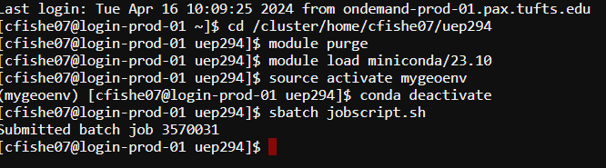
Open questions
Is training data representative?
Are there non-target confounding species?
Why do some areas like the Stony Brook Reservation vary so widely between models?
Would higher spatial resolution improve results?
Why were so many processes so slow and why did they require the MGHPCC?

Slide 27
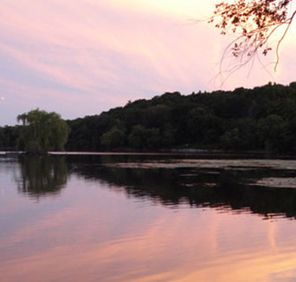
Further Work…
Distinguish between species?
Expand study area?
Modify geographic/spatial RF to show feature importance?
Improved training data?
Investigate changes over time?
Notes:
https://www.emeraldnecklace.org/park-overview/jamaica-pond/

Slide 28
Predicting Invasive Understory Species Presence in Boston’s Deciduous Forests
Chad Fisher | UEP 294 | Final Project | 4.24.24
Notes:
https://www.tclf.org/sites/default/files/thumbnails/image/MA_Boston_FranklinPark_courtesyEmeraldNecklaceConservancy_2020_001_sig.jpg

Slide 29
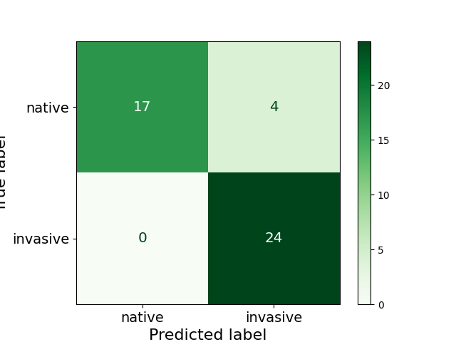
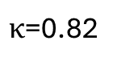
$κ$=0.82
User’s Accuracy: 100% for native, 86% for invasive
Producer’s Accuracy: 100% for invasive, 81% for native
Overall Accuracy: 91%

Slide 30
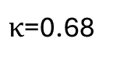
$κ$=0.68
User’s Accuracy: 100% for native, 77% for invasive
Producer’s Accuracy: 100% for invasive, 67% for native
Overall Accuracy: 84%

Slide 31
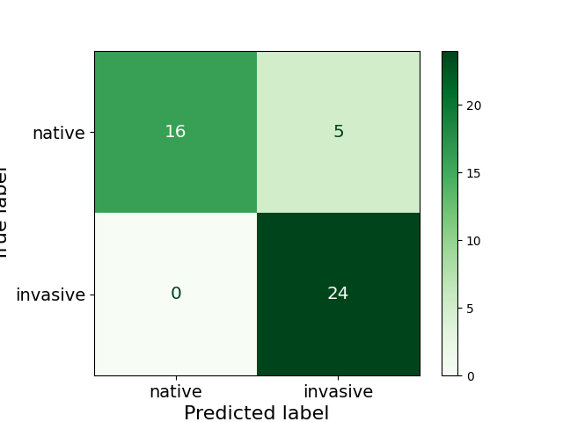
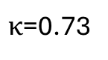
$κ$=0.73
User’s Accuracy: 76.2% for native, 95.8% for invasive
Producer’s Accuracy: 94.1% for invasive, 82.1% for native
Overall Accuracy: 86.7%

Slide 32
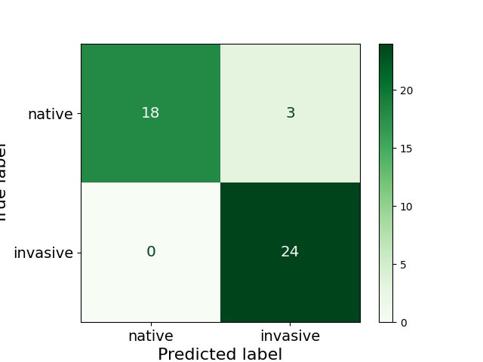
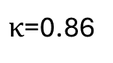
$κ$=0.86
User’s Accuracy: 85.7% for native, 100% for invasive
Producer’s Accuracy: 100% for invasive, 88.9% for native
Overall Accuracy: 93.3%

